Slide 1
Eliciting Accurate Requirements & Documenting Business Requirements
DEPARTMENT OF CSE COURSE NAME – ADAPTIVE Software Engineering
COURSE CODE – 22CI2001
Session -8

Slide 2



AIM OF THE SESSION
To familiarize students with the basic concept of eliciting accurate requirements
To familiarize students with the basic concept of Documenting Business Requirements
INSTRUCTIONAL OBJECTIVES
This Session is designed to:
Describe Requirements elicitation
List out the Requirements elicitation Methods
Describe the Advantages and Disadvantages of Requirements Elicitation
Describe the Features of requirements elicitation
Define business requirement document
Describe how to write a business requirement document
LEARNING OUTCOMES
At the end of this session, you should be able to:
Define Requirement elicitation
Describe Advantages, Disadvantages of requirements elicitation
Define business requirement document
Describe how to write a business requirement document

Slide 3

SESSION DESCRIPTION
Requirements Elicitation Introduction
Requirements elicitation is the process of gathering and defining the requirements for a software system. The goal of requirements elicitation is to ensure that the software development process is based on a clear understanding of the customer’s needs and requirements.
Requirements elicitation involves the identification, collection, analysis, and refinement of the requirements for a software system.
It is a critical part of the software development life cycle and is typically performed at the beginning of the project. Requirements elicitation involves stakeholders from different areas of the organization, including business owners, end-users, and technical experts.
The output of the requirements elicitation process is a set of clear, concise, and well-defined requirements that serve as the basis for the design and development of the software system.
Requirements elicitation is perhaps the most difficult, most error-prone, and most communication-intensive software development. It can be successful only through an effective customer-developer partnership. It is needed to know what the users really need.
Requirements elicitation is perhaps the most difficult, most error-prone, and most communication-intensive software development. It can be successful only through an effective customer-developer partnership. It is needed to know what the users really need.

Slide 4
Requirements elicitation Methods
Interviews
Brainstorming Sessions
Facilitated Application Specification Technique (FAST)
Quality Function Deployment (QFD)
Use Case Approach

Slide 5

Interviews:
Objective of conducting an interview is to understand the customer’s expectations from the software. It is impossible to interview every stakeholder hence representatives from groups are selected based on their expertise and credibility.
Interviews maybe be open-ended or structured.
In open-ended interviews there is no pre-set agenda. Context free questions may be asked to understand the problem.
In structured interview, agenda
of fairly open questions is prepared.
Sometimes a proper questionnaire is
designed for the interview.

Slide 6
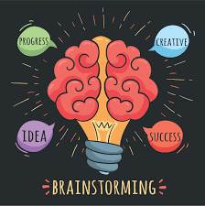
2. Brainstorming Sessions
It is a group technique
It is intended to generate lots of new ideas hence providing a platform to share views
A highly trained facilitator is required to handle group bias and group conflicts.
Every idea is documented so that everyone can see it.
Finally, a document is prepared which
consists of the list of requirements
and their priority.

Slide 7

3. Facilitated Application Specification Technique:
Its objective is to bridge the expectation gap – the difference between what the
developers think they are supposed to build and what customers think they are going to get. A team-oriented approach is developed for requirements gathering. Each attendee is asked to make a list of objects.
Each participant prepares his/her list, different lists are then combined, redundant entries are eliminated, team is divided into smaller sub-teams to develop mini-specifications and finally a draft of specifications is written down using all the inputs from the meeting.

Slide 8
4. Quality Function Deployment: In this technique customer satisfaction is of prime concern, hence it emphasizes on the requirements which are valuable to the customer. 3 types of requirements are identified –
Normal requirements – In this the objective and goals of the proposed software are discussed with the customer. Example – normal requirements for a result management system may be entry of marks, calculation of results, etc
Expected requirements – These requirements are so obvious that the customer need not explicitly state them. Example – protection from unauthorized access.
Exciting requirements – It includes features that are beyond customer’s expectations and prove to be very satisfying when present. Example – when unauthorized access is detected, it should backup and shutdown all processes.

Slide 9

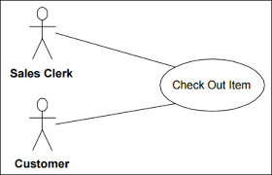
5. Use Case Approach: This technique combines text and pictures to provide a better understanding of the requirements. The use cases describe the ‘what’, of a system and not ‘how’. Hence, they only give a functional view of the system. The components of the use case design includes three major things – Actor, Use cases, use case diagram.
Actor – It is the external agent that lies outside the system but interacts with it in some way. An actor maybe a person, machine etc. It is represented as a stick figure. Actors can be primary actors or secondary actors.
Primary actors – It requires assistance from the system to achieve a goal.
Secondary actor – It is an actor from which the system needs assistance.
Use cases –
They describe the sequence of interactions between actors and
the system. They capture who(actors) do what(interaction) with
the system. A complete set of use cases specifies all possible ways
to use the system.

Slide 10
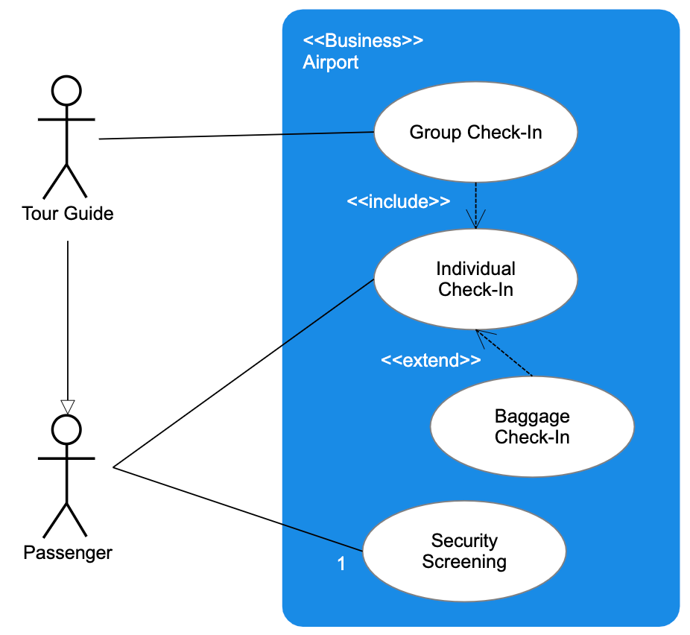
USECASE DIAGRAM:
A use case diagram graphically represents
what happens when an actor interacts
with a system. It captures the functional
aspect of the system.
A stick figure is used to represent an actor.
An oval is used to represent a use case.
A line is used to represent a relationship
between an actor and a use case.

Slide 11
Features of requirements elicitation:
Stakeholder engagement: Requirements elicitation involves engaging with stakeholders such as customers, end-users, project sponsors, and subject matter experts to understand their needs and requirements.
Gathering information: Requirements elicitation involves gathering information about the system to be developed, the business processes it will support, and the end-users who will be using it.
Requirement prioritization: Requirements elicitation involves prioritizing requirements based on their importance to the project’s success.
Requirements documentation: Requirements elicitation involves documenting the requirements in a clear and concise manner so that they can be easily understood and communicated to the development team.

Slide 12
Validation and verification: Requirements elicitation involves validating and verifying the requirements with the stakeholders to ensure that they accurately represent their needs and requirements.
Iterative process: Requirements elicitation is an iterative process that involves continuously refining and updating the requirements based on feedback from stakeholders.
Communication and collaboration: Requirements elicitation involves effective communication and collaboration with stakeholders, project team members, and other relevant parties to ensure that the requirements are clearly understood and implemented.
Flexibility: Requirements elicitation requires flexibility to adapt to changing requirements, stakeholder needs, and project constraints.

Slide 13
Advantages of Requirements Elicitation:
Helps to clarify and refine customer requirements.
Improves communication and collaboration between stakeholders.
Increases the chances of developing a software system that meets customer needs.
Avoids misunderstandings and helps to manage expectations.
Supports the identification of potential risks and problems early in the development cycle.
Facilitates the development of a comprehensive and accurate project plan.
Increases user and stakeholder confidence in the software development process.
Supports the identification of new business opportunities and revenue streams.

Slide 14
Disadvantages of Requirements Elicitation:
Can be time-consuming and expensive.
Requires specialized skills and expertise.
May be impacted by changing business needs and requirements.
Can be impacted by political and organizational factors.
Can result in a lack of buy-in and commitment from stakeholders.
Can be impacted by conflicting priorities and competing interests.
May result in incomplete or inaccurate requirements if not properly managed.
Can lead to increased development costs and decreased efficiency if requirements are not well-defined.

Slide 15
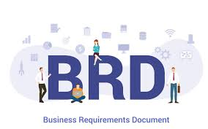
SESSION DESCRIPTION
BUSINESS REQUIREMENT DOCUMENT
A business requirement document (or a BRD) is a well-structured formal description of an upcoming project. It explains why a company needs to build a new software or a business solution. BRDs also cover the problems projects will solve and how much money they will bring (or how much a company may lose if the software isn’t built).

Slide 16
Why are Business Requirement Documents Important?
BRDs paint a complete picture of a potential project. These documents bring together all the teams involved in a project launch and ensure successful project delivery.
How to Write a Business Requirement Document
Start with executive summary.
Communicate business objectives.
Explain the project’s background and why it’s needed.
Set scope of work.
Define the project’s functionality requirements.
Identify key stakeholders.
Communicate project constraints.
Set a schedule.
Summarize cost-benefit analysis.

Slide 17
Start with your executive summary.
Executive summaries describe a project concisely. An executive summary should capture the following:
Current pain points and how they affect the business.
What we offer as a solution.
Relevant data
A deadline for the project.
Executive summary should be easy to understand so that anyone can be able to understand just by reading this section.

Slide 18
2. Communicate business objectives.
List the business objectives we hope to achieve with the project.
Objectives should be specific, measurable, attainable, relevant, and time-Bound.
If we cannot specify the numbers or it’s hard to predict them, detail specific results that we hope to achieve from the full implementation of the project.

Slide 19
3. Explain the project’s background and why it’s needed.
Name a few urgent issues we aim to solve with the project. Provide data and research to support our statement. For instance, we can compare current and expected spending. Be sure to include a summary of past experiments or projects in this section.
The history section outlines previously successful projects and those that could have run more smoothly. By doing so, this section establishes precedents and how the next project can be more effective using information from previous projects.

Slide 20
4. Set your scope of work.
This is the most important part of your BRD. This section should include:
A detailed overview of project objectives.
Milestones.
Project deliverables.
Acceptance criteria.
Our scope of work identifies what needs to be done within a specific period. Be sure to clearly communicate the project requirements for every step of development. This fosters clear communication between stakeholders and team members who will be working on the project. We’ll also mitigate the risk of the project veering off course.

Slide 21
5. Define the project’s functionality requirements.
List all the features and necessary functionality of the product. This section includes what needs to be built and any features our new project requires. We can also describe this section under the Scope of Work.
Functional requirements are product features or functions that developers must implement to enable users to accomplish their tasks. So, it's important to make them clear both for the development team and the stakeholders. Generally, functional requirements describe system behavior under specific conditions.

Slide 22
6. Identify your key stakeholders.
A stakeholder is any professional affected by a business's operations, projects and victories. Stakeholders vary in the type and amount of interest they have in a company.
A key stakeholder is among the most important stakeholders for a company. Key stakeholders are highly interested in a particular company's success, as they are most affected by its business. Likewise, a business's success and growth often depend upon its key stakeholders.
Types of key stakeholders: Customers,Employees,Investors,Company leaders.

Slide 23
6. Identify your key stakeholders.
Here are the five steps to identify the key stakeholders at your company:
1. Review the stakeholders
2. Understand the purpose behind identifying key stakeholders
3. Determine their impact on operations
4. Learn their needs in relation to our business
5. Prioritize the list

Slide 24
7. Communicate project constraints.
It’s essential to specify the existing boundaries that affect project development. Our constraints can be anything from our budget, current toolkit, technical limitations, team availability, or dependencies.
Time – When it needs to be delivered
Cost – What is our budget
Scope – The details of what needs to be delivered
Resources – Who and what we need to deliver it
Risks – Often overlooked or unaddressed
Quality – Something that works quick vs the perfect delivery later

Slide 25
8. Set a schedule
Work hand in hand with our project managers to specify deadlines for each phase of our initiatives. BRDs for external clients should include final deadlines and estimated delivery dates around milestones.
A cost-benefit analysis determines whether the project's benefits outweigh its costs. Create a spreadsheet that outlines current expenses and budget lost by inefficiencies. Forecast the amount of money and other benefits a company will gain.
The goal is to convince executives that a new project is worth the investment. Show our case by presenting facts and figures.
9. Summarize your cost-benefit analysis.

Slide 26
SELF-ASSESSMENT QUESTIONS
Define Requirements elicitation.
What are the features of requirements elicitation.
What are different methods in requirements elicitation.
Advantages of Requirements elicitation
Define business requirement document
Describe how to write a business requirement document

Slide 27
REFERENCES FOR FURTHER LEARNING OF THE SESSION
Reference Books:
2. TEXT BOOKS:
Roger S.Pressman, “Software Engineering – A Practitioner’s Approach” 7th Edition, Mc Graw Hill,(2014).
Ian Sommerville, “Software Engineering”, Tenth Edition, Pearson Education, (2015).
Reference Book
Agile and Iterative Development: A Manager's Guide, Craig Larman, Addison-Wesley
WEB REFERNCES/MOOCS:
https://www.digite.com/kanban/what-is-kanban/
http://www.scaledagileframework.com
https://www.guru99.com/test-driven-development.html
https://junit.org/junit5/

Slide 28
THANK YOU
Team – Adaptive Software Engineering

